Slide 1
www.CUSDNUTRITION.com

Slide 2
SNAPSHOTS OF THE INDUSTRIES

Slide 3
SNAPSHOT OF SCHOOL NUTRITION
Elementary Participation
49%
Junior High Participation
41%
Menu
Changes = Minimal Impact on Participation
Same Audience, Same Cyclical Students

Slide 4
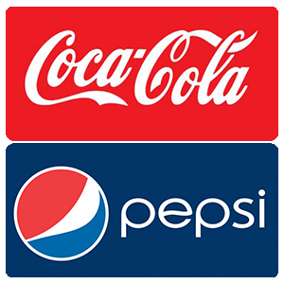
SNAPSHOT OF RETAIL MARKET
Removing all Artificial Additives by 2016
Removing all Artificial Colors & Flavors
Removing Preservatives & HFCS
Changing Caramel Coloring & Artificial Sweeteners

Slide 5
OUR CHALLENGE

Slide 6
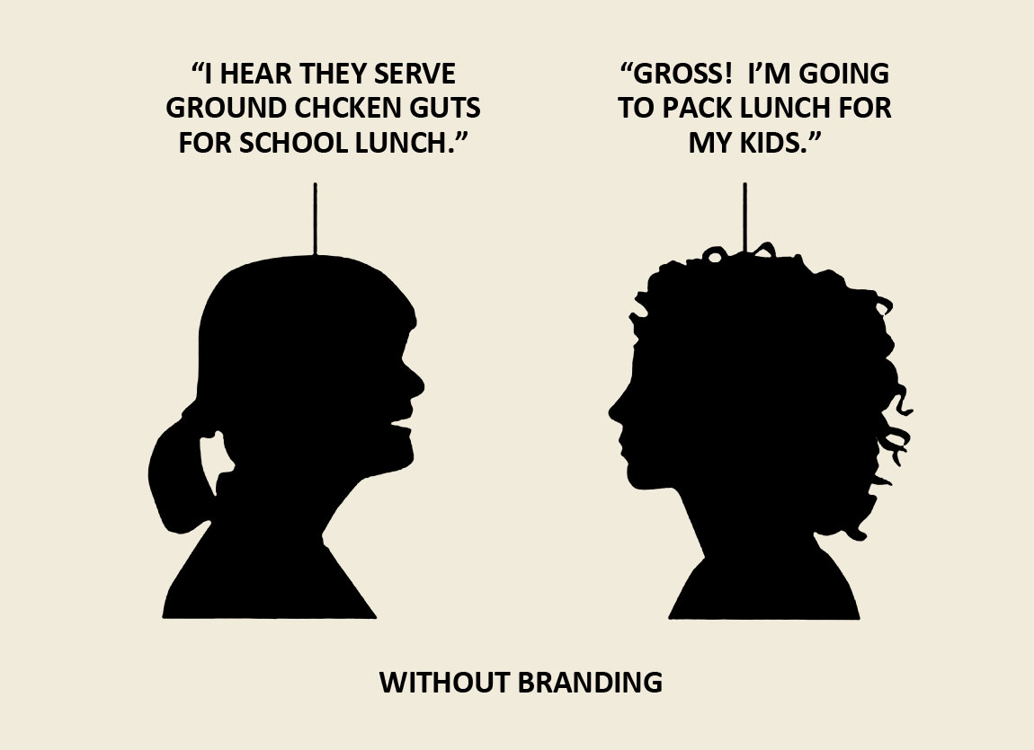
Notes:
A conversation that could happen in anyone’s district, and how it would go if you had a weak brand. It begins with a little misinformation. The lady on the left has heard that they….which would be pretty alarming to anyone who hasn’t had any brand exposure, and it may lead to them making a mistake like deciding to not participate in your nutrition program. Because you may have been silent or ineffective at communicating your brand, there was an absence of information. And in the absence of information, people assume the worst.

Slide 7
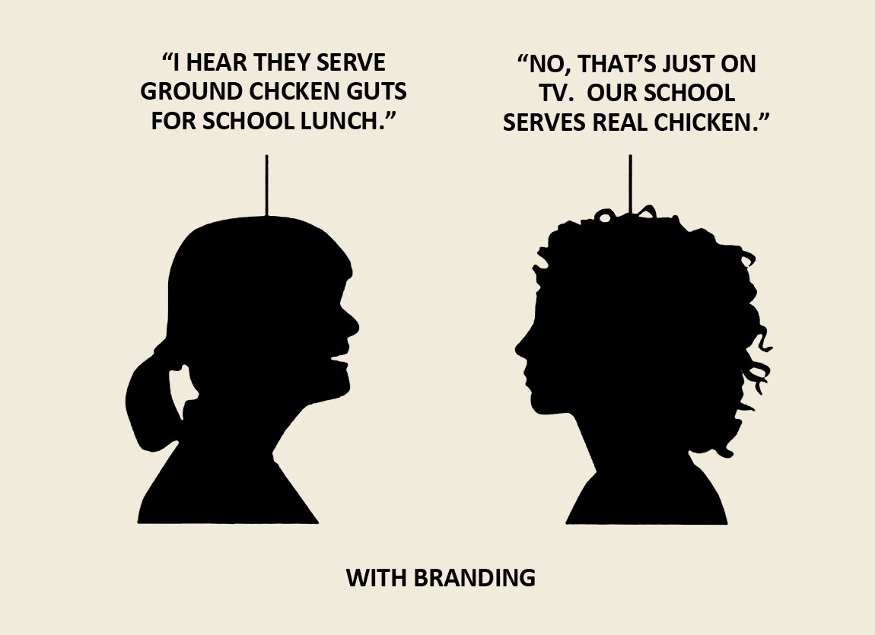
Notes:
Let’s look at the situation if there were some strong branding involved, and if you did have a strong voice. It begins the same way, with the same misinformation. But that is quickly refuted by a brand evangelist, who actually knows some facts about your program. Not only is the brand evangelist not swayed by the lady who is misinformed, but it’s likely that she’ll help win her over. The presence of information that you provided has created someone who can be your advocate – they’re there to speak on your behalf, even when you never knew the conversation was happening.
Whether you like it or not, these conversations are happening right now. In your district. They’re happening in people’s homes, over the telephone, and even online. The main difference between today and yesterday is – you now have tools available to you that will help you find these conversations and insert yourself.

Slide 8
The Next Big Thing….

Slide 10
PHASE I : 2015-16
Commitment to Change
Work to eliminate artificial flavors, colors, hydrogenated fats & high fructose corn syrup by 2016-17
A total of 30 food additives

Slide 11
Artificial
Flavors
PRESERVATIVES
MSG
BHA
BHT
NITRATES
TBHQ
Artificial
Colors
Hydrogenated
Fats & Oils
Benzoates
HFCS

Slide 12
PHASE II : 2017-2020
By 2020, commit to removing ALL artificial additives that reflect Whole Foods Standards

Slide 13
Whole Foods Standards
~70 ingredients that are not allowed on their shelves
Set standards for purchasing decisions
Influences manufacturers’ formulations

Slide 14
Why Not CUSD Nutrition?

Slide 15
Vision Into Process
Waves of change with timeline
Processing as “normal” but with strong attention to ingredients
Transparency of ingredients online and mobile app
High level of communication with parents & teachers

Slide 16
CUSD Nutrition aims to achieve a nutritional program in which we use whole ingredients in their purest form while creating meals & snacks that our students truly enjoy. We are working alongside local farmers and suppliers to ensure our standards are met at the BEGINNING of the food production process.
We are also making a commitment to improve transparency, and will provide complete ingredient information of all food served to your student through our online menus.

Slide 17
VALUE ADD

Slide 18
NET PROMOTER SCORE
On a scale of 1-10, how likely are you to recommend CUSD Nutrition to someone else?
Tracks how customers represent your brand to
family, friends, associates, etc.

Slide 19
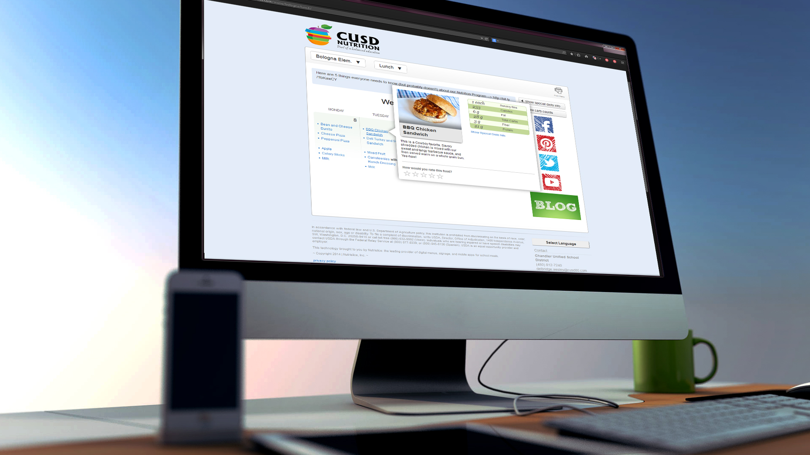
ONLINE MENUS

Slide 20
DIGITAL SIGNAGE

Slide 21
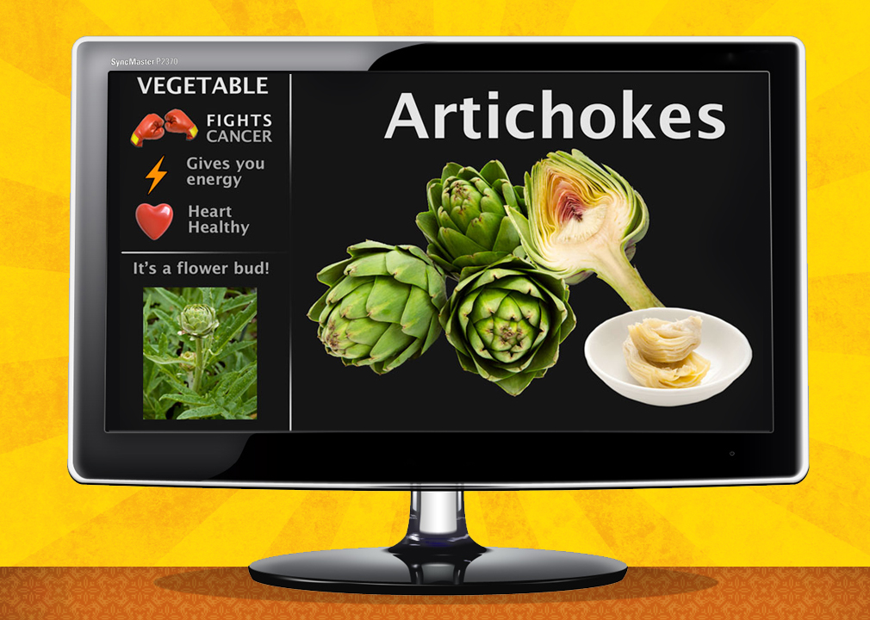

Slide 22
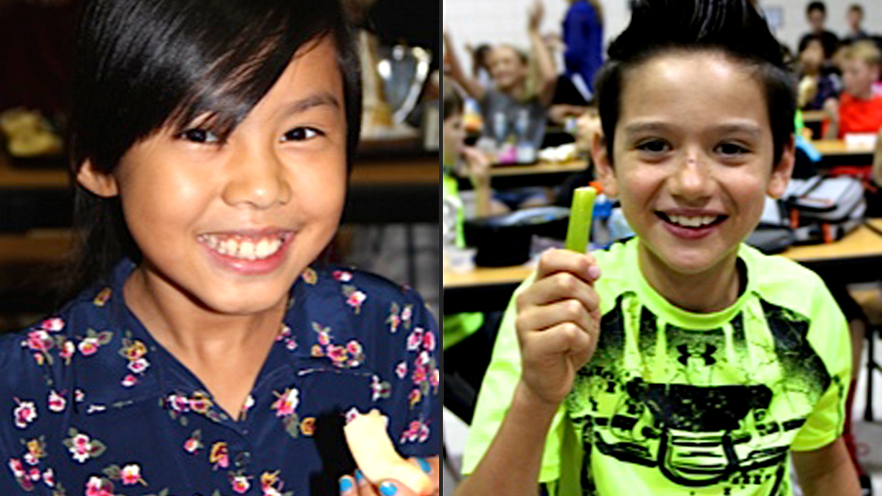
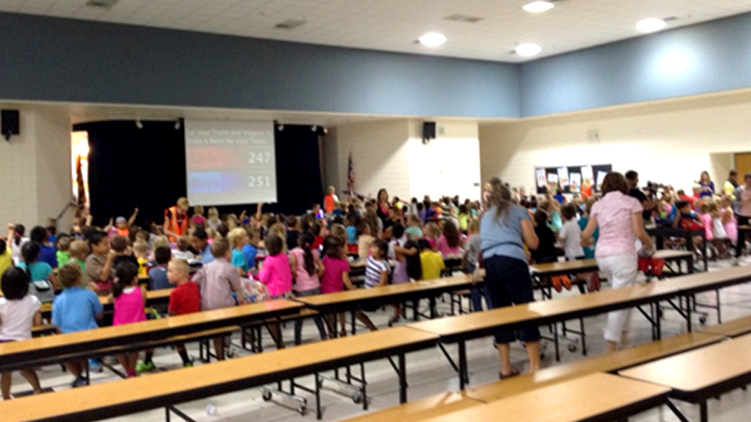
DIGITAL SIGNAGE EVENTS

Slide 24
WEBSITE

Slide 25
WWW.CUSDNUTRITION.COM

Slide 26
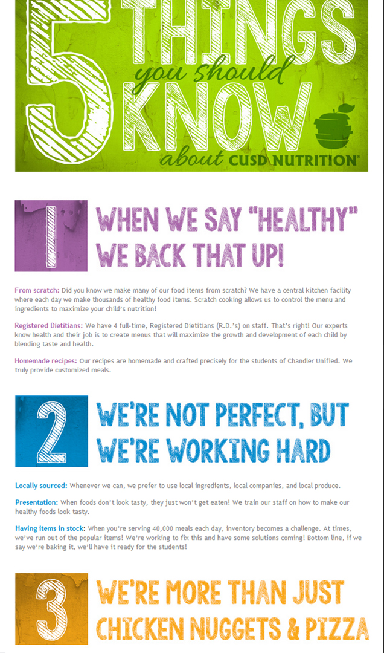
WEBSITE DESIGN

Slide 27
SOCIAL MEDIA

Slide 28
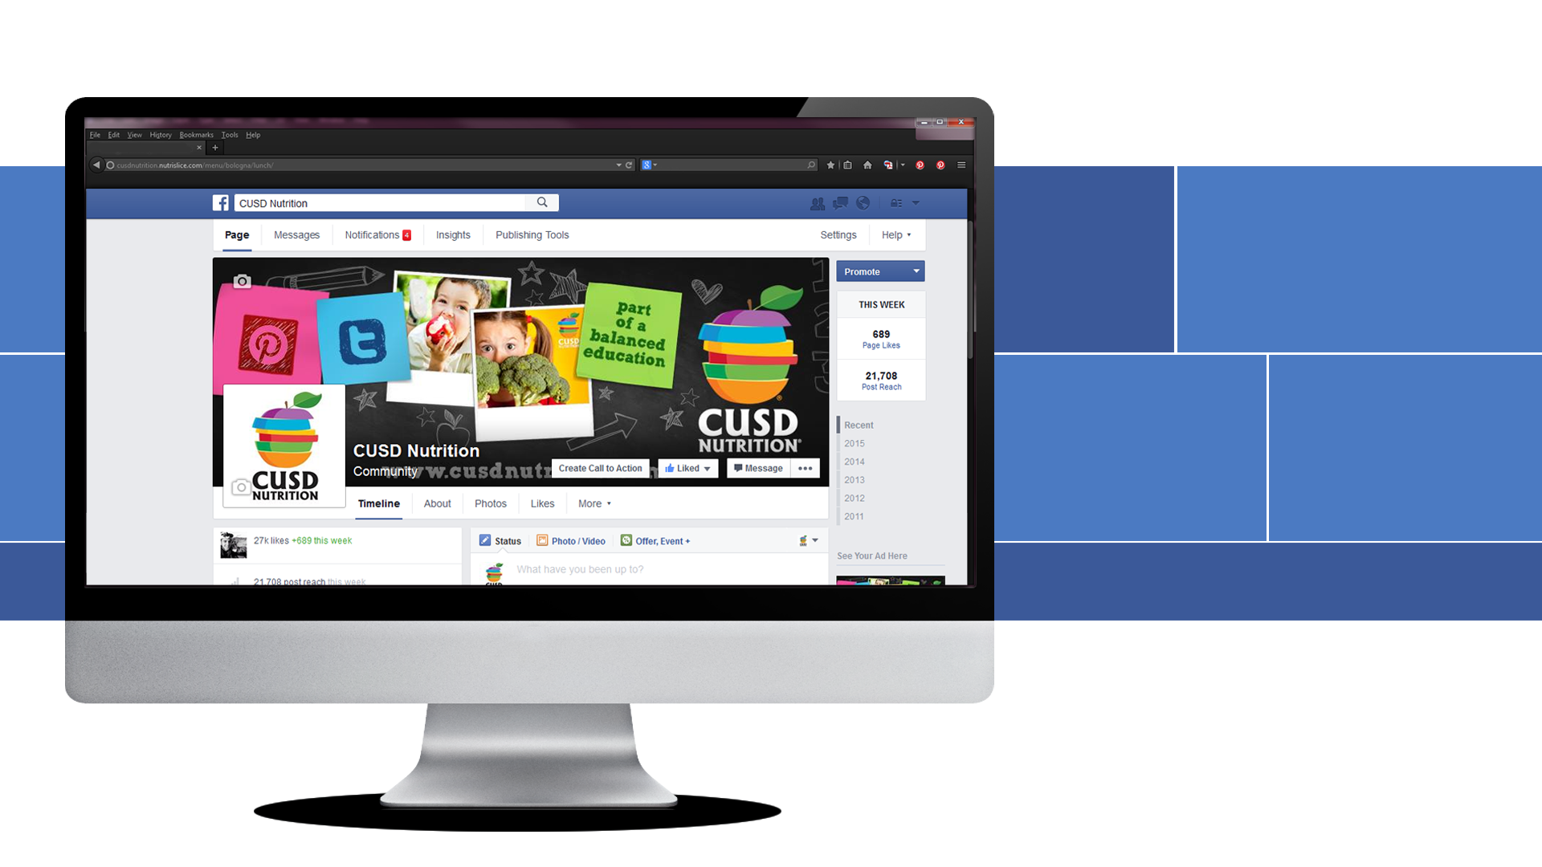
27,768
PAGE LIKES/FOLLOWERS
2.4k
VISITS
12,930
AVG. POST REACH
www.facebook.com/cusdnutrition
Telling our Story, Engaging Customers, Changing Perceptions
Input ► Dialogue ► Action ► Customer Satisfaction
Better informed students, parents & staff

Slide 29
4,681
FOLLOWERS
2,091
TWEETS
#schoollunch
#childhoodobesity
www.twitter.com/CUSDNutrition

Slide 30
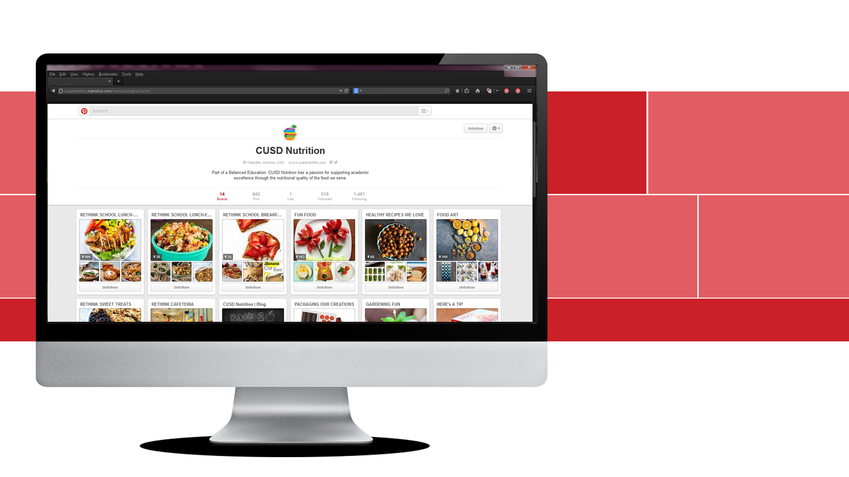
843
PINS
319
FOLLOWERS
14
BOARDS
www.pinterest.com/cusdnutrition

Slide 31
9,678
VIEWS*
7,017
VISITORS*
65
POSTS*
https://cusdnutrition.wordpress.com/
*AUG 2014 – JUN 2015

Slide 32
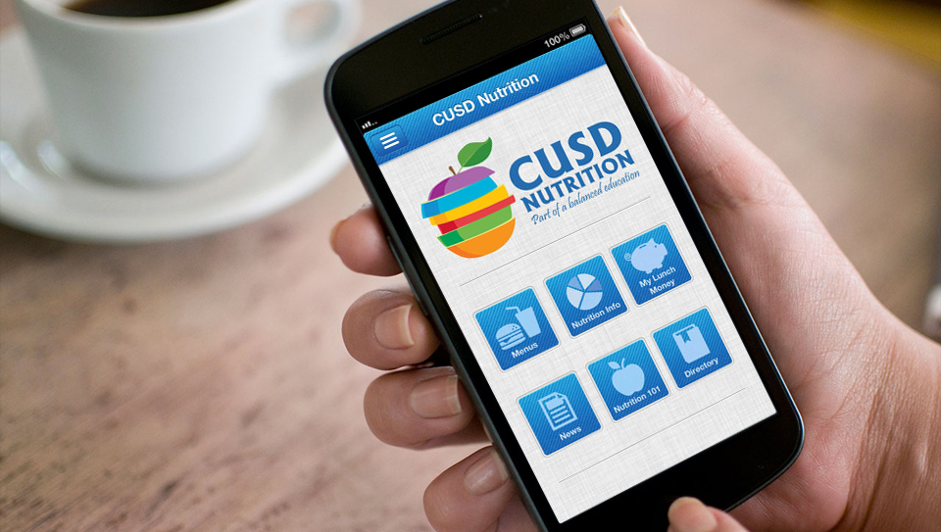
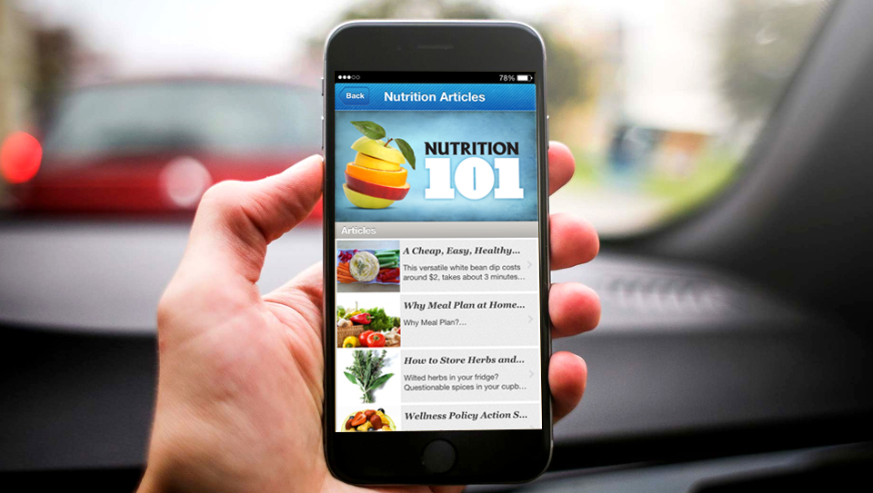
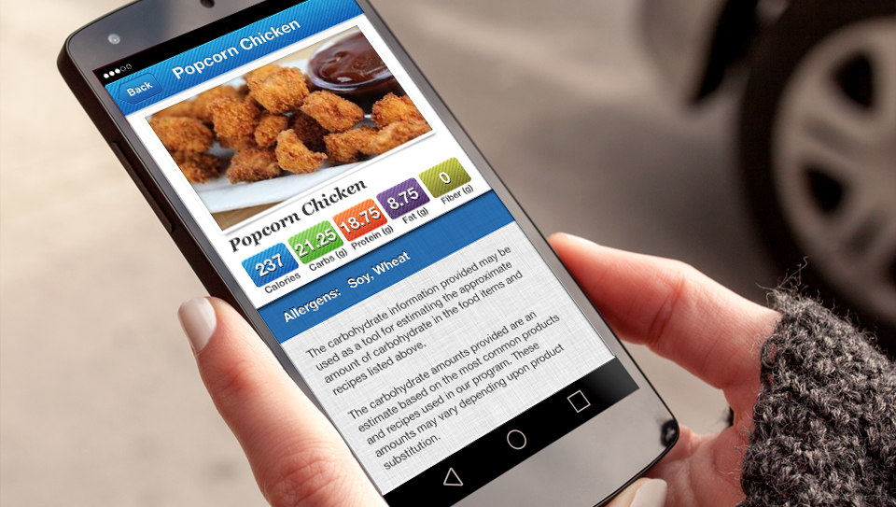

Slide 33
WHAT IS AHEAD?

Slide 34
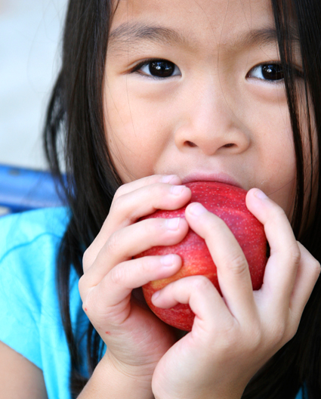
THE FUTURE
Parent & Student Feedback
Improving Technology & Communication
Customer Experiences

Slide 36
www.CUSDNUTRITION.com

